Slide 1
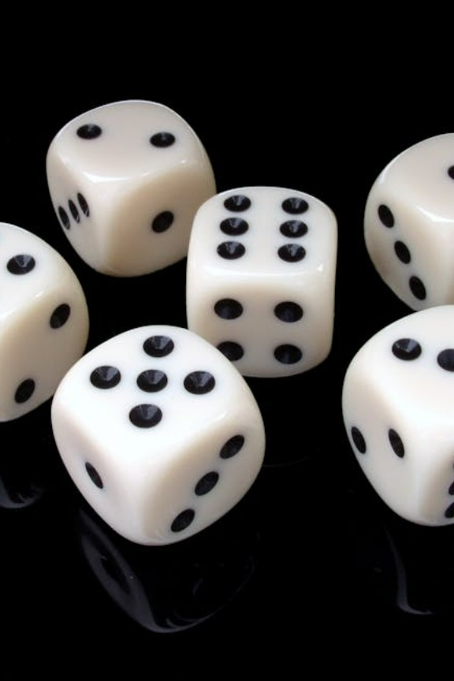
Probability Basics for AI
Today’s Agenda
What is Probability? Why it matters in AI
Types of Probability: Theoretical, Experimental, Conditional
Basic Rules: Addition & Multiplication
Independent vs Dependent Events
Real AI Applications of Probability
Hands-On Practice
Kahoot(Quiz)

Slide 2
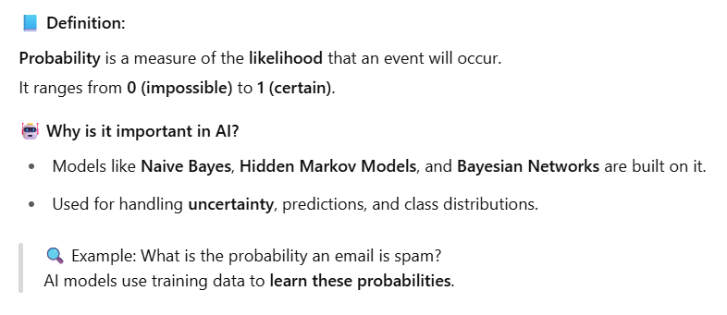
What is Probability & Why It Matters in AI
Naïve Bayes :- probability for eg:- emails spam messages (prob ko aadhar ma )
Hidden Markov Models :- action lai herera event predictions
Bayesian :- collection of nodes to form a probability

Slide 3
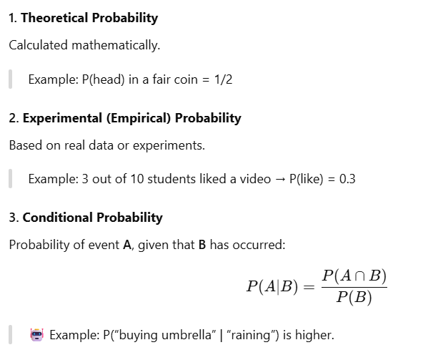
Types of Probability

Slide 4
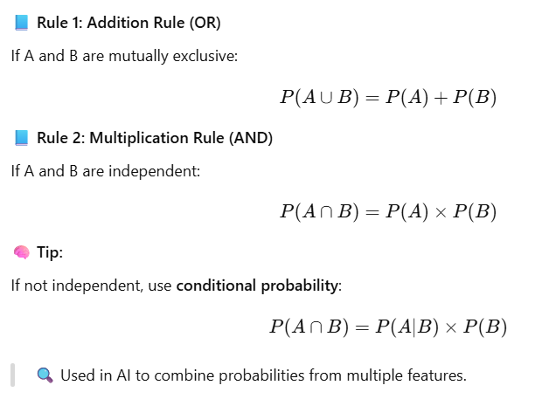
Basic Probability Rules

Slide 5
Short break

Slide 6
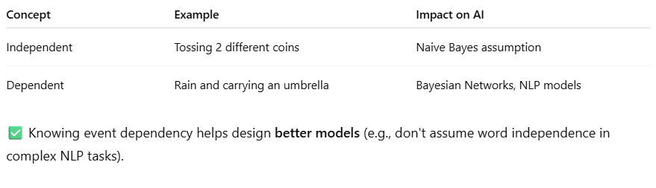
Independent vs Dependent Events
NLP : Natural Language Processing
Eg:- I love (placeholder of you) yo word bata further k hunxa predict garne ?

Slide 7
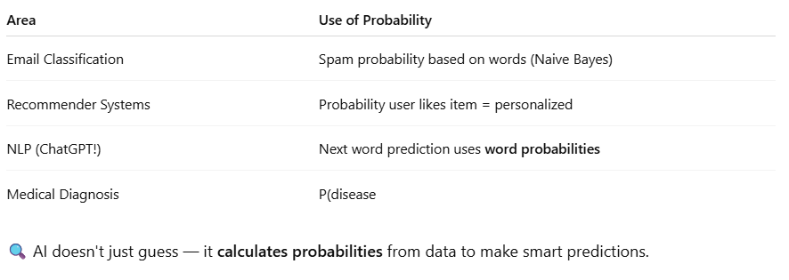
Real Applications of Probability in AI

Slide 8
Main Break

